Slide 1
User Positioning by Exploring MIMO Measurements with
Particle Swarm Optimization
Dr. Zhenyu Shi and Dr. Yi Wang
5G Lab, Huawei Technologies Co., Ltd.
Email: yi.wang@Huawei.com
2017-10-11, IEEE PIMRC 2017, Montreal

Slide 2
Introduction
User positioning in mobile communication system has incurred increasing interests in 5G applications. 5G requires for high accuracy location estimation
The particle swarm optimization (PSO) approach can be applied to search the best position in terms of a fitness function and has shown capacity approaching performance in SISO
In MIMO, the time of arrivals (TOA) measurements from different Tx to different Rx can be used with PSO to further exploit the antenna diversity and improve the estimation accuracy
  Two fitness functions for PSO with MIMO-TOA measurements are proposed
  The localization performance is compared with the two functions

Slide 3
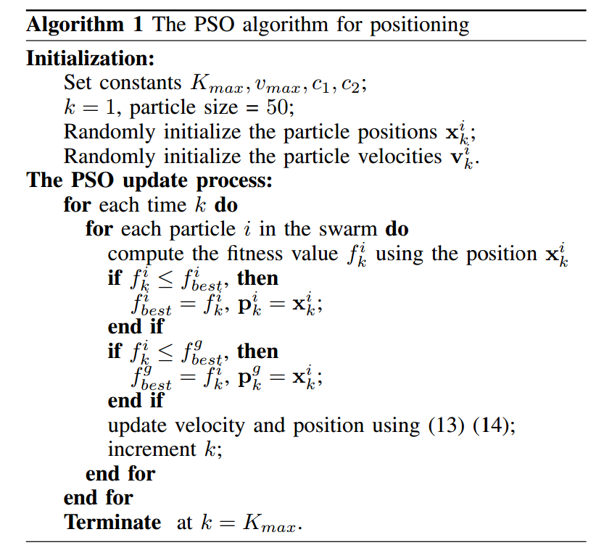
PSO algorithm
The main goal of PSO algorithm is to search the position which maximizes/minimizes the fitness function in a given area.
In case of MIMO, the fitness function is given by MIMO-TOA measurements in multiple antennas

Slide 4

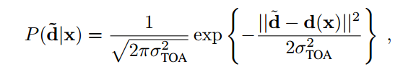

MIMO Measurement Model
BS2(0,D_{I})
BS4(D_{I},D_{I})
The measured distance from the t-th antenna of the n-th BS to the r-th receive antenna is given by
The measurement error is assumed to be Gaussian distributed.
Given $\tilde{d}$ is the vector containing distance from all antennas, the pdf is expressed by
d_{2,t,r}
d_{4,t,r}
d_{3,t,r}
d_{1,t,r}
BS1(0,0)
BS3(D_{I},0)

Slide 5


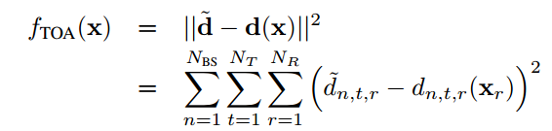
MIMO Measurement Model
BS2(0,D_{I})
BS4(D_{I},D_{I})
The ML estimation:
Since the measurements are i.i.d. Gaussian distributed, the ML estimator is equivalent to NLS estimator:
where
d_{2,t,r}
d_{4,t,r}
d_{3,t,r}
d_{1,t,r}
BS1(0,0)
BS3(D_{I},0)

Slide 6



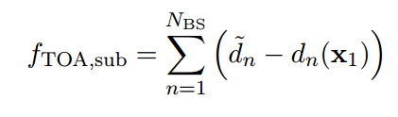
Two Fitness Functions
Optimal fitness function
  Assuming ULA, UE antennas’ positions are all related to
  the first antenna position by
  The fitness function is then of the form
Suboptimal fitness function
  The distance measurement from one BS to UE can be computed by averaging over all antennas:
  Then, the suboptimal function is

Slide 7
Configurations
Parameters | BW=20MHz | BW=200MHz
BS interval | 500m (Macro) | 200m (Micro),
Number of BSs | 4 BSs including serving BS
TOA Distance error Distribution | N~(0, 20²m²) | N~(0, 5²m²)
Number of Tx | 1,2,4 | 1,2,4
Number of Rx | 1,2 | 1,2

Slide 8
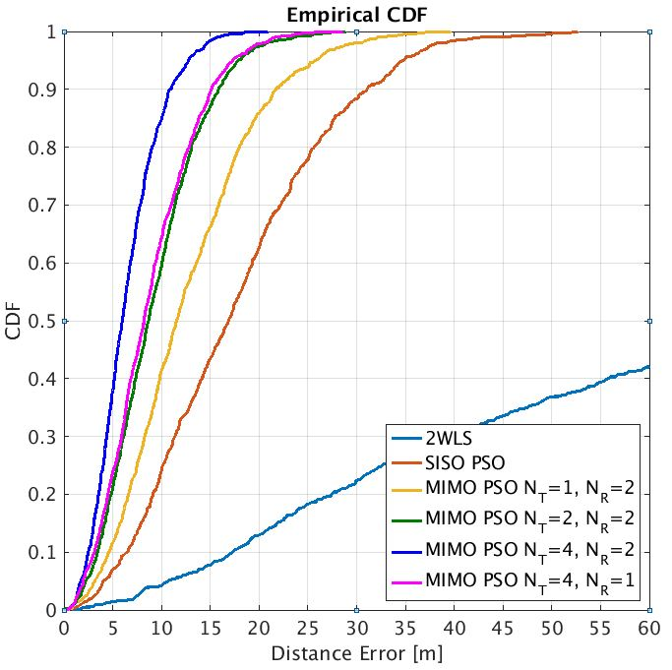
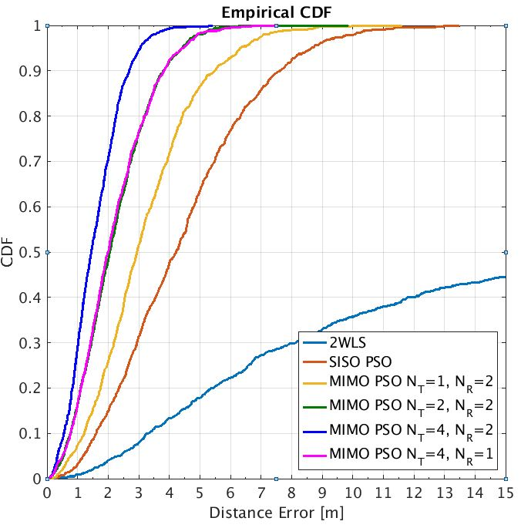
Effects of Antenna Numbers
LF
HF
The estimation accuracy increases linearly with $\sqrt{N_{T}N_{R}}$

Slide 9
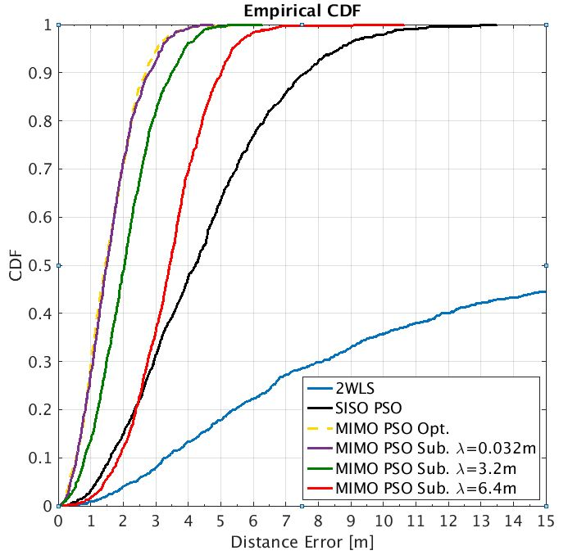
Effects of Fitness Functions
When antenna spacing is much smaller than UE-BS distance, the performance of two fitness functions is almost the same
When antenna spacing is comparable to the UE-BS distance, the suboptimal function shows worse estimation quality

Slide 10

Conclusions
PSO is applied to estimate user positions by minimizing the fitness function for MIMO-TOA measurements
Two approaches for computing the fitness functions are proposed
  The estimation error can be reduced linearly with $\sqrt{N_{T}N_{R}}$
  When antenna spacing is smaller than UE-BS distance, the suboptimal solution can reduce the complexity without performance degradation
PSO can be combined with MIMO for high accuracy localization

