Slide 1
Jointly Positioning Multiple Users in Aid of User-to-User Distances Dr. Yi Wang, Beihua Wu, Zhenyu Shi 5G Lab, Huawei Technologies Co., Ltd. Email: yi.wang@Huawei.com 2017-10-11, IEEE PIMRC 2017, Montreal

Slide 2
Introduction
User localization in mobile communications has been well studied in the past decades. Typical methods are range-based localization (e.g. 2WLS), AOA-based localization, RF fingerprint, and SLAM etc.
Typical measurements are TOA, TDOA, AOA, RSS etc.
Measurements are always poor in 3G and 4G systems.
High-accuracy localization needs good measurements as well efficient localization algorithms. Introducing measurements from sensors (e.g. RADAR ranging and D2D measurements) are possible in 5G.
RADAR in V2X scenario can achieve range accuracy of 0.02~0.5m
IEEE802.11xx based on FTM can achieve range accuracy of 0.1~5m
This paper has two contributions:
A multiuser positioning method in aid of user-to-user (U2U) distances is proposed. To authors’ knowledge, few publications are working on the multiuser positioning.
we apply particle swarm optimization (PSO) to estimate user position.

Slide 3
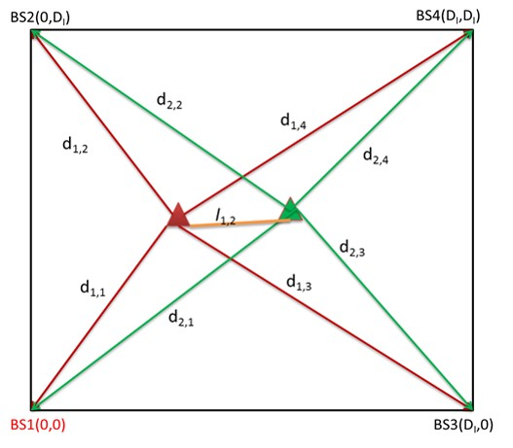
Localization model
TOA measurements model:
U2U measurements model:

Slide 4
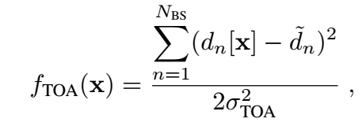
Fitness functions
Single user:
Multiple users:

Slide 5
Particle swarm optimization

Slide 6
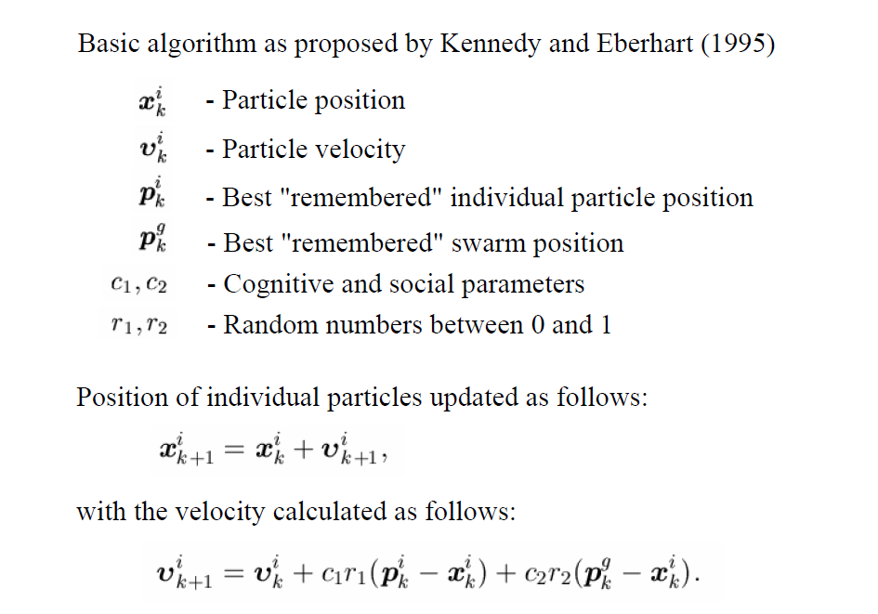
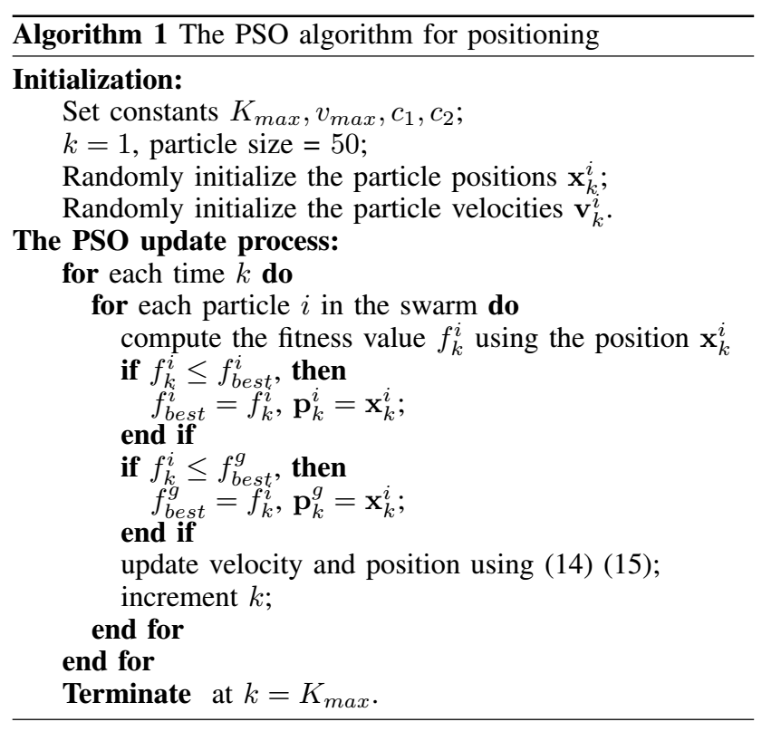
Particle swarm optimization

Slide 7
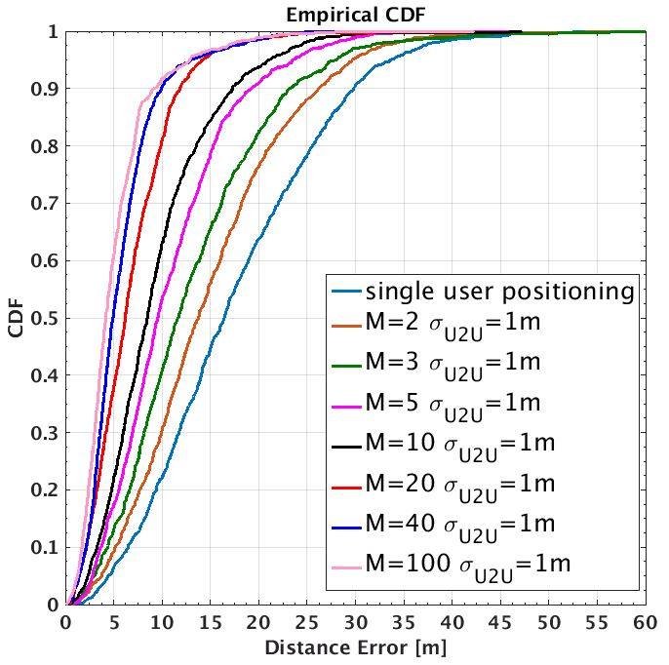
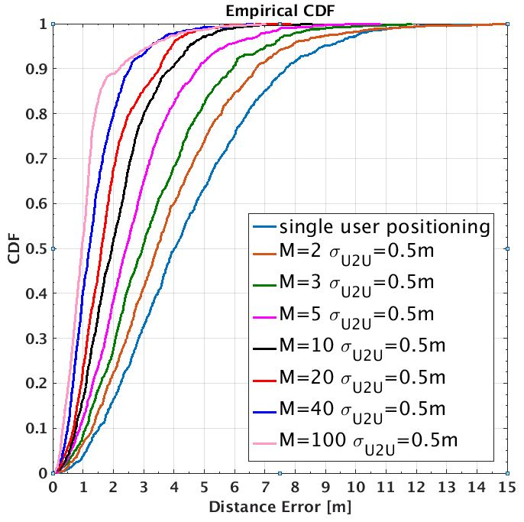
Simulations – number of users
Localization accuracy is improved as increasing the number of users.

Slide 8
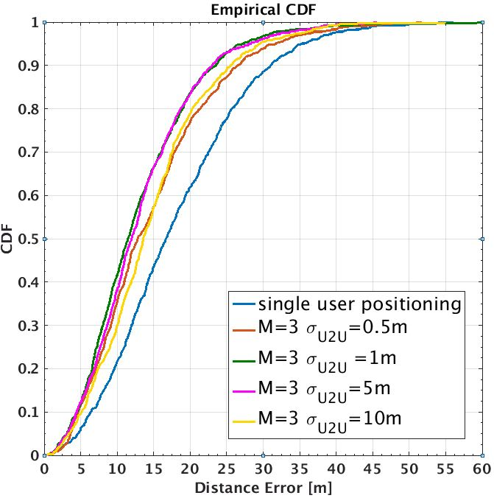
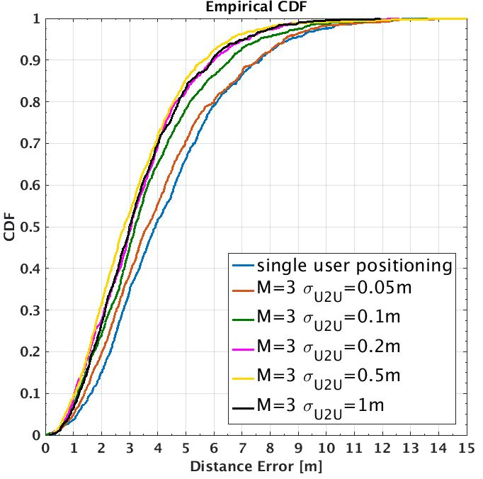
Simulations – U2U measurement errors
LTE system may achieve 5-10 meters accuracy whereas 5G mmWave can achieve 2-3 meters accuracy.

Slide 9
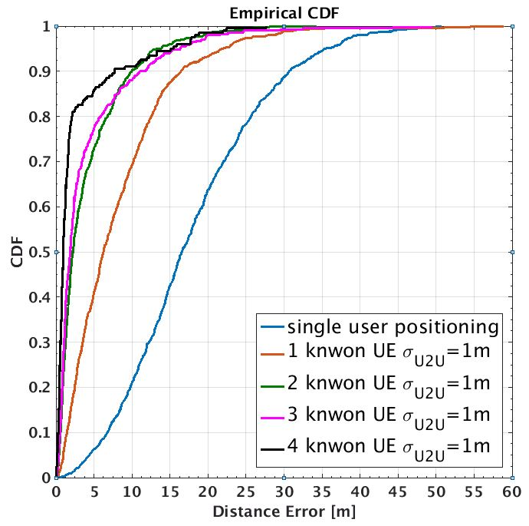
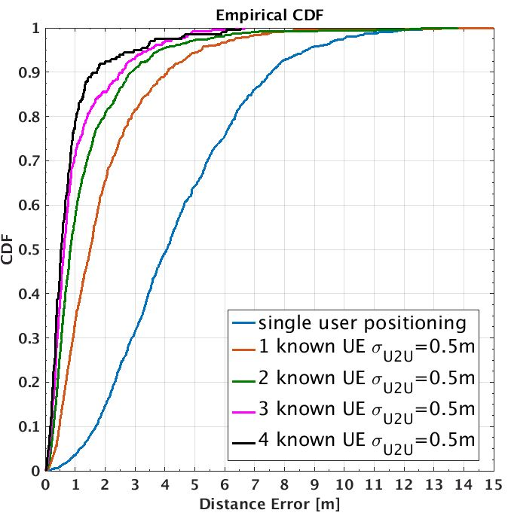
Simulations – with partial nodes known
Priori information of partial nodes (location) is helpful to improve localization accuracy.

